Slide 1

PREDICTION OF CAR ACCIDENTS SEVERITY
capstone Project
BY CHENG YAT YEUNG

Slide 2
Content
Introduction
Data Understanding and Preparation
Data Analysis and Visualization
Deployment Model and Evaluation
Conclusion

Slide 3
Introduction
Traffic collision is one of the most common accidents in modern society.
It often results in injury, disability, death, and property damage.
In 2013, 54 million people worldwide sustained injuries from traffic collisions;
And caused 1.4 million deaths.
It raises a serious concern for many citizens around the world.

Slide 4
INTRODUCTION CON’T
Car accidents can take place due to serval reasons, e.g. vehicle design, driver negligence, road environment, traffic condition etc.
It is important to predict the severity of the car accidents under different conditions.
The purpose of this project is to predict the severity of an accident, the cause for these accidents and suggest how to reduce the number of accidents by training an efficient machine learning model with the help of existing accidents data.

Slide 5
Data Preparation
The dataset used in this project contains data about car accidents provided by SPD and recorded by Traffic Records.
The dataset provides several attributes such as the weather during the time of accident (WEATHER), road condition (ROADCOND), visibility of the area (LIGHTCOND) and type of road junction (JUNCTIONTYPE).
Main objective of this step is to get the pre-selected variable for machine learning. It includes the steps Exploratory Data Analysis, dealing with missing values, dropping features and converting the data types.

Slide 6
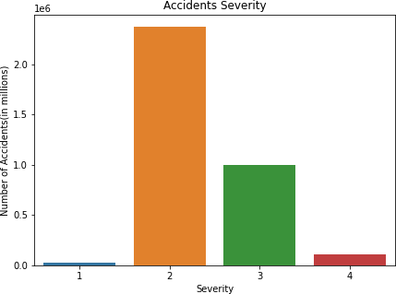
Data Analysis and Visualization
We are performing the analysis of the available dataset using different features.
Most accidents happened during the daytime, especially AM peak and PM peak. When it comes to night, accidents were far less but more likely to be serious.

Slide 7
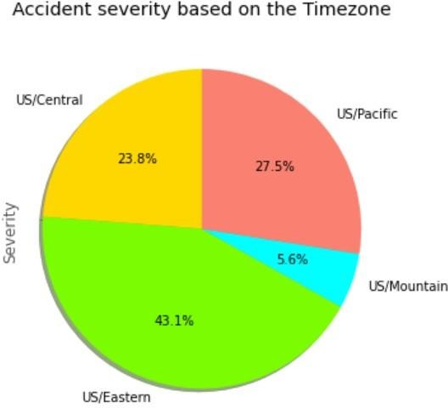
Data Analysis and Visualization
Most of the accidents occur Clear and Fair conditions.

Slide 8
Data Analysis and Visualization
Based on the above visualizations of US Accidents dataset after Exploratory Data Analysis highly impacted Features with values are:
Weekdays other than weekends
US Eastern Areas
Right side of the Roads
Daytime
Clear and Fair cloud condition
Wind is Calm and Western Side

Slide 9
Conclusion
This section summarizes the findings on Accident Severity Prediction obtained from both EDA and the Data Analysis section of this report.
Above analysis are clearly providing the counterintuitive answers to the questions.
Our Analysis mainly demonstrate the top categories of the Weather conditions, Time Features, POI features shows that Clear, Calm, Traffic signal, Eastern areas and Sunlight are the ones with high accident occurring features even though the weather conditions were bad, Heavy Storm and visibility also poor.

